Slide 1
Solving problems by searching
Chapter-3

Slide 2
Problem solving agents
Problem can be defined through five components:
  Initial state
  Actions available
  Transition model (What each action does)
  Goal test
  Path cost
Different search solutions can solve these problems.

Slide 3
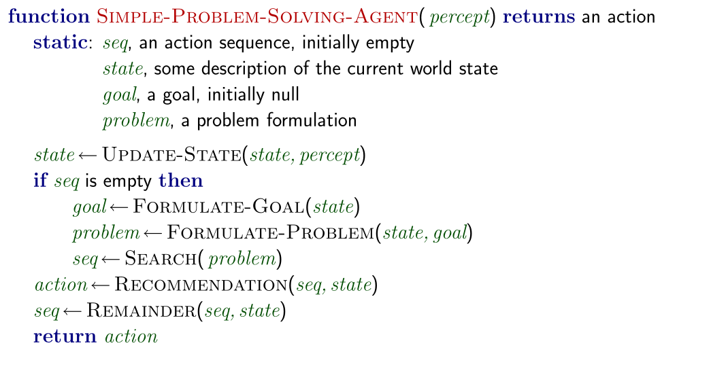
Problem solving agents
Restricted form of general agent

Slide 4
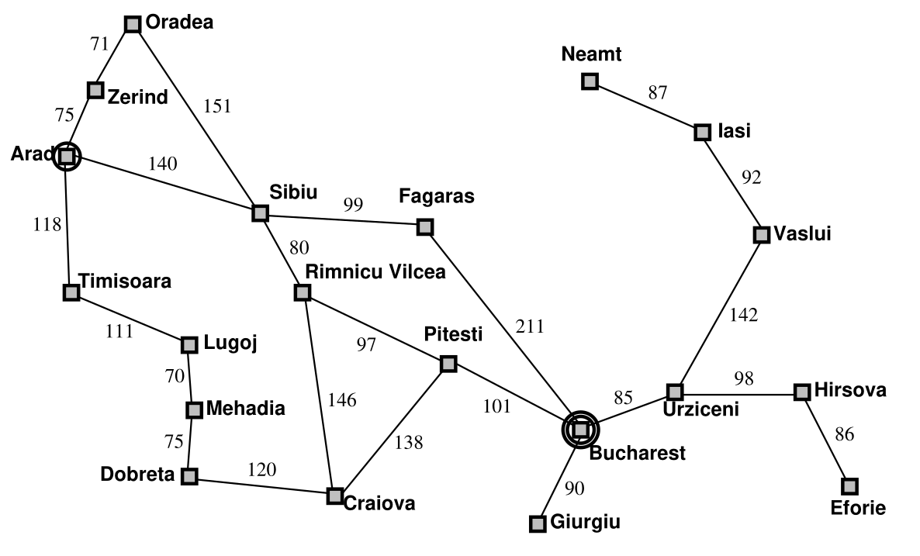
Problem solving agents – Example Romania

Slide 5
Problem solving agents – Example Romania
On a holiday in Romania: currently in Arad.
Flight leaves tomorrow from Bucharest
Formulate goal:
  Be in Bucharest
Formulate problem:
  States: various cities
  Actions: Drive between cities
Find solution:
  Sequence of cities e.g. Arad, Sibiu, Fagaras, Bucharest

Slide 6
Problem solving agents – Example Romania
Problem can be defined through five components:
  Initial state: In (Arad)
  Actions available: Go (Sibiu), Go (Timisoara), Go (Zerind)
  Transition model: RESULT (In(Arad ), Go(Zerind )) = In(Zerind )
  Goal test: {In(Bucharest )}
  Path cost: c(s, a, s’). Action a, taken in state s, to reach to s’, has cost c.

Slide 7
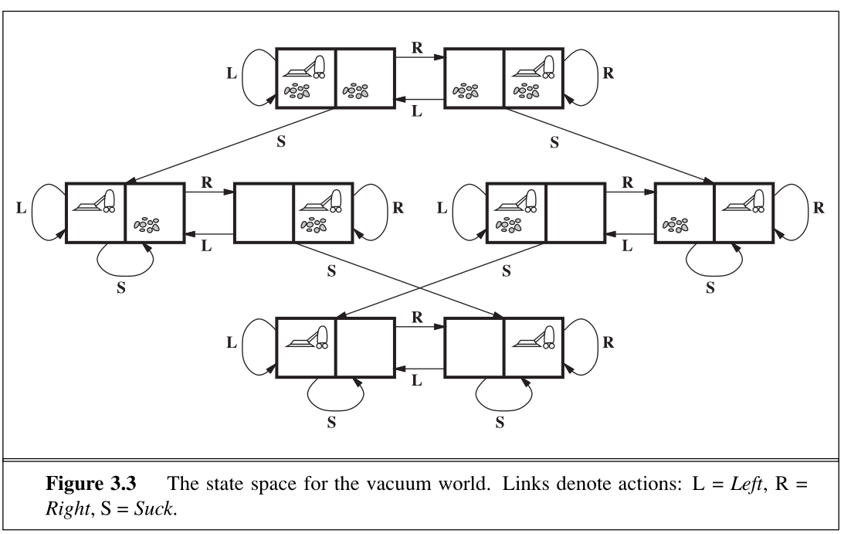
Problem solving agents – Vacuum World

Slide 8
Problem solving agents – Vacuum World
Problem can be defined through five components:
  States: 2 x 2² = 8 possible states
  Initial state: Any state can be start state.
  Actions available: Left, Right, Suck
  Transition model: Complete state space shown in previous slide
  Goal test: If all squares are clean
  Path cost: Each step cost 1.

Slide 9
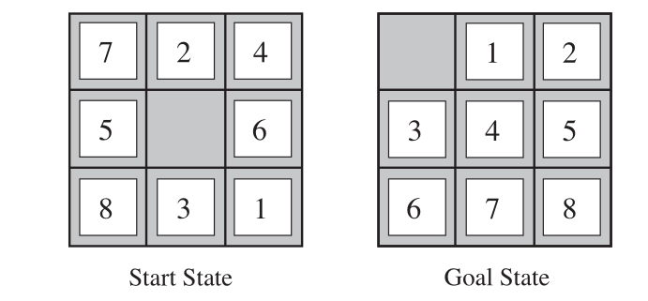
Problem solving agents – 8 puzzle problem

Slide 10
Problem solving agents – 8-puzzle problem
Problem can be defined through five components:
  States: Location of each of the eight tiles, the blank is one of the 9th tile
  Initial state: Any state can be start state.
  Actions available: Movement of blank space Left, Right, Up, Down
  Transition model: Complete state space shown in previous slide
  Goal test: Goal configuration achieved or not? Can have different goals
  Path cost: Each step cost 1.
Belongs to sliding block puzzle problem. NP-Complete problem.
8-puzzle has 9!/2=181,440 reachable states
15-puzzle (4x4) has 1.3 trillion states. Best search can solve in milli-seconds
24-puzzle (5x5) has 10²⁵ states. It takes several hours to solve.

Slide 11
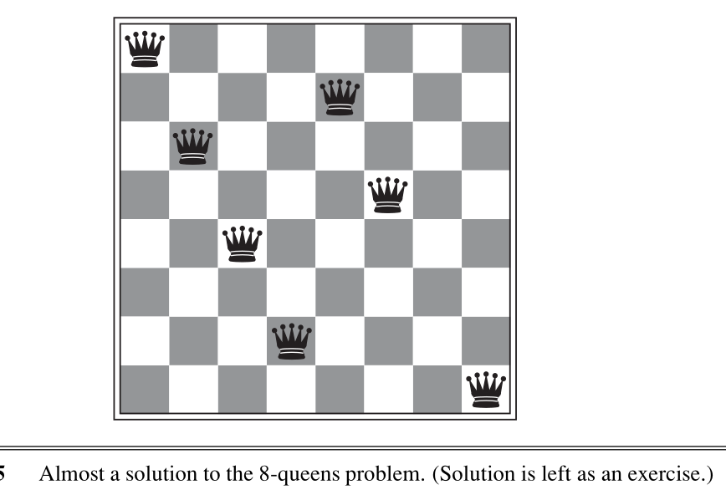
Problem solving agents – 8 queens problem
Place eight queens on chessboard so that no queen attack any other.

Slide 12
Problem solving agents – 8 queen problem
Problem can be defined through five components:
  States: Any arrangement of 0 to 8 queens on the board is a state.
  Initial state: No queens on the board.
  Actions available: Add a queen to an empty square.
  Transition model: Returns the board with a queen added.
  Goal test: 8 queens are on the board, none attacked.
We have 64x63… 57 = 1.8 x 10¹⁴ possible sequences to investigate.
Another solution
  States: Any arrangement in which queens are placed one per column.
  Actions: Add a queen to any square in the leftmost empty column such that it is not attacked. Hence the state space is reduced to 2057 possibilites.

Slide 13
Problem solving agents –Real world problems
Route finding problem
  Touring problem: Each city is visited.
  TSP: Each city is visited once.
  VLSI Layout: Cell layout, channel routing.
  Robot Navigation: Continuous space routing problem.
  Automatic assembly sequencing: Sequence of steps to be followed.
  Protein Design: Design sequence of amino acids. To fold into 3D protein

